Slide 1
Introduction to Lean 4
Wang Yutong@NUS

Slide 2
Prove Theorem
Simple proof

Slide 3
Tactic proof
Over 300 different tactics in Mathlib
Simple: exact, rw, apply, rfl, calc …
Our target
Medium: simp, ring, group, field_simp, …
Advanced: linarith, norm_num, rify, omega…
Prove by calculation!
Super: aesop, ?, …

Slide 4
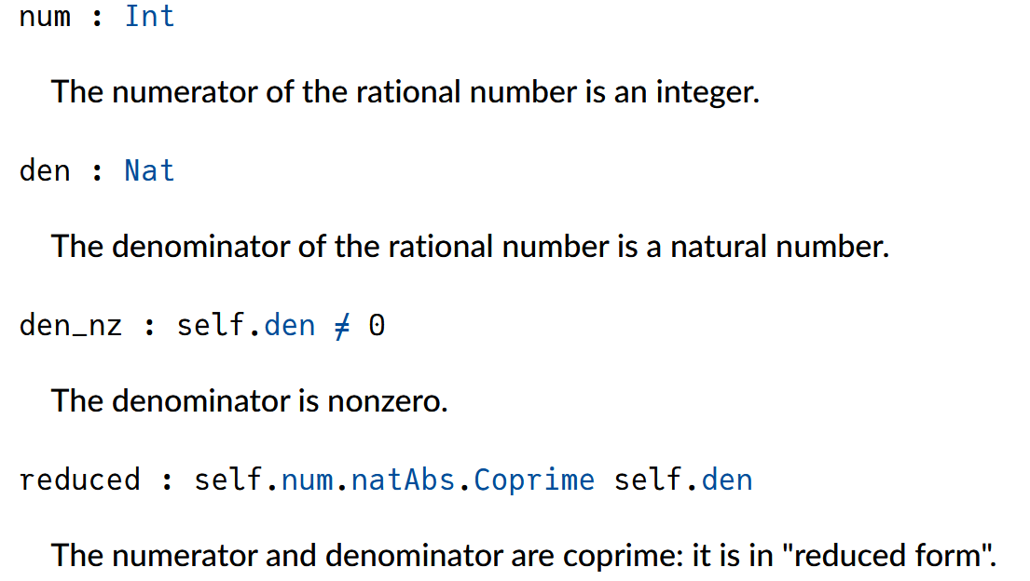
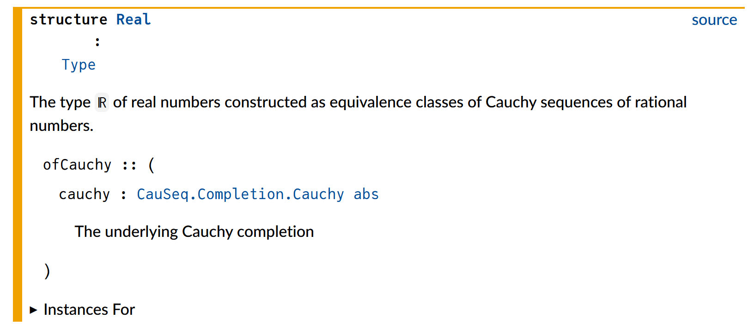
Fact about Real number
Axiomatization:
To define a theory by stating a set of primitive axioms
Rational number: r =(a, b)
a b are integers,
b ≠ 0,
a b are coprime
Real number:
equivalence classes of Cauchy sequences in rational numbers (Completion of Rational)
Pi = 3, 3.1, 3.14, 3.1415, …

Slide 5
Fact about Real number
Group
(ℝ, 0, +)
Add Commutative Group:
(ℝ, 0, +)
Commutative Ring: r =(a, b)
(ℝ, 0, 1, +, *)
Group with Zero:
0^-1 = 0
a / 0 = a * 0^-1 = a * 0 = 0
Field:
(ℝ, 0, 1, +, *)
group
abel
ring
field_simp

Slide 6
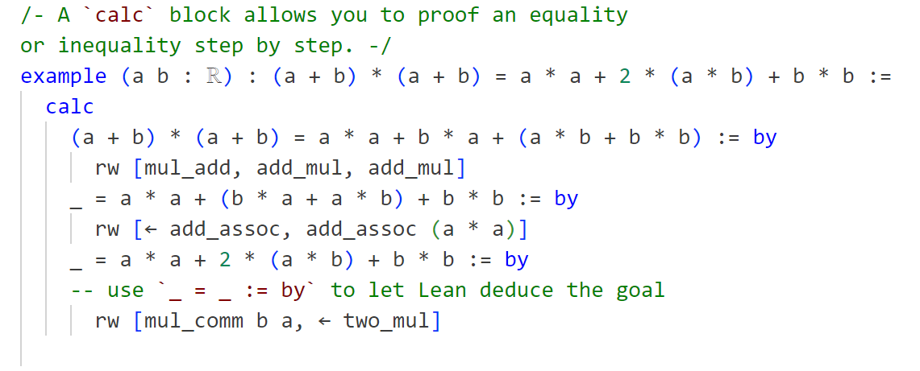
Prove by calculation
A Calc Block: Prove theorem by calculation
Natural language
Lean 4

Slide 7
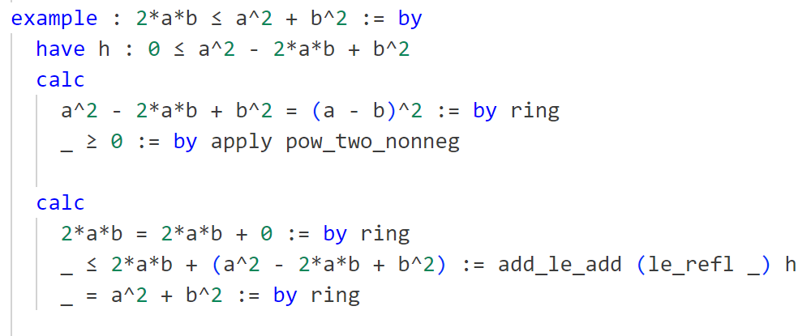
Prove BY calculation
Proving Inequality

Slide 8
Prove by calculation
What is a calc block in essence? Some key words.
Relations (X, ❤️)
Reflexive: for all x : X, x ❤️ x (=, ~, …)
Symmetric: for all x, y : X, x ❤️ y implies y ❤️ x (=, ~, …)
Transitive: for all x, y, z: X, x ❤️y and y ❤️ z together implies x ❤️ z (<, <=, >, >=, …)
…
❤️ is an equivalent relation, if it is reflexive, symmetric and transitive. (=, <->)
Calc block take advantages of `trans` relation and ‘connect’ the inequalities
rfl
Eq.symm
le_trans, lt_trans
a < x < y < z
calc
_ < x := proof1
_ < y := proof2
_ < z := proof3
Proof1
proof1.trans proof2.trans proof3
Proof2
Proof3

Slide 9
Prove by logic
Universal Quantifiers
Existence Quantifiers

Slide 10
some recent Tools
Search, translate and prove

Slide 11
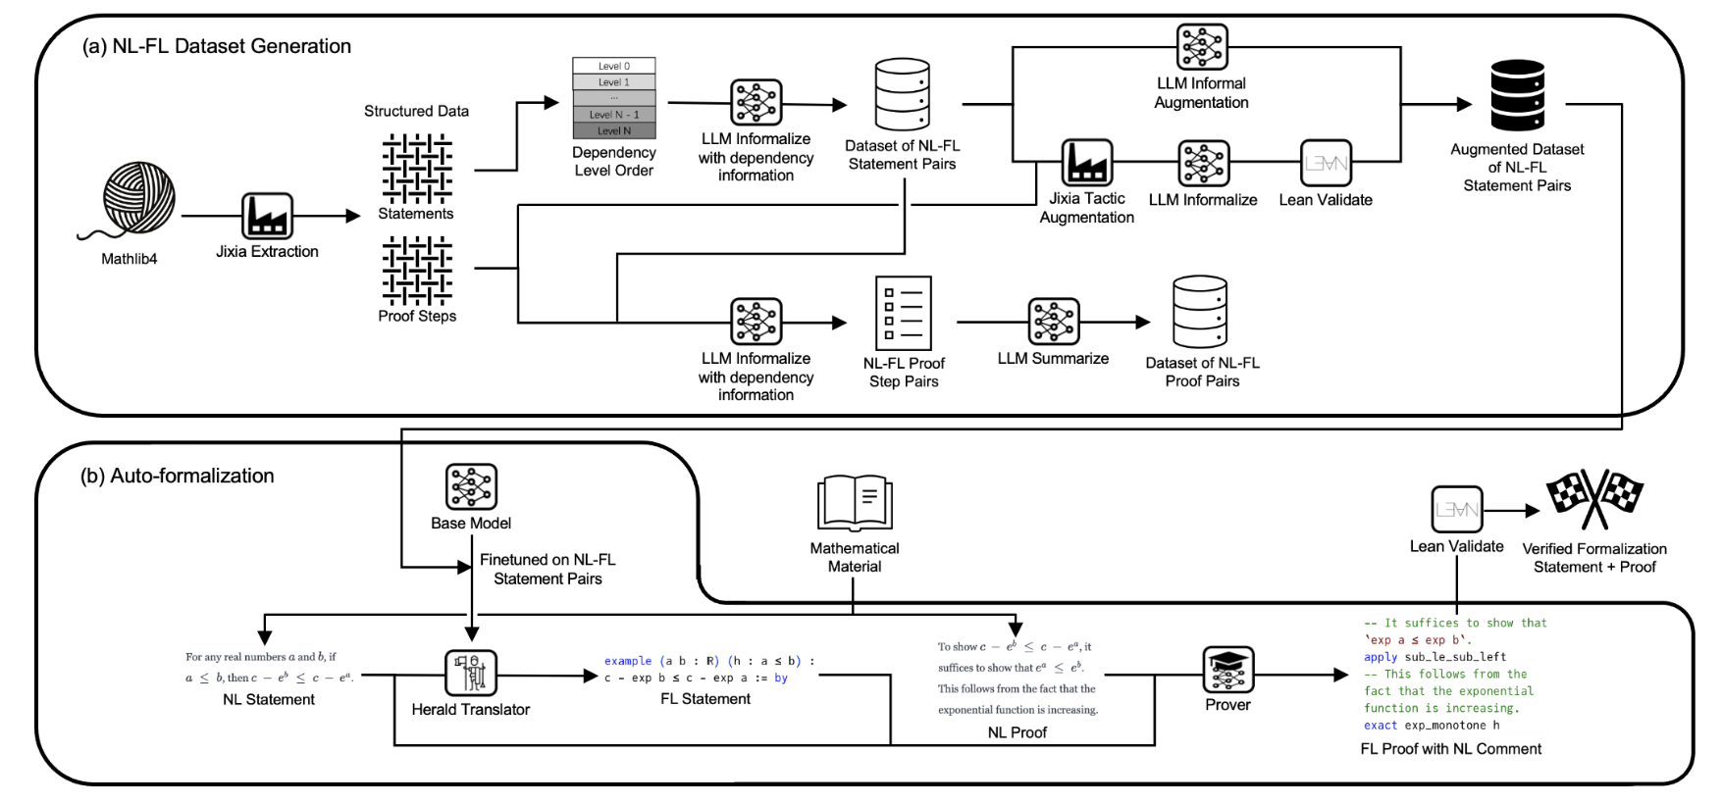
Lean translator

Slide 12
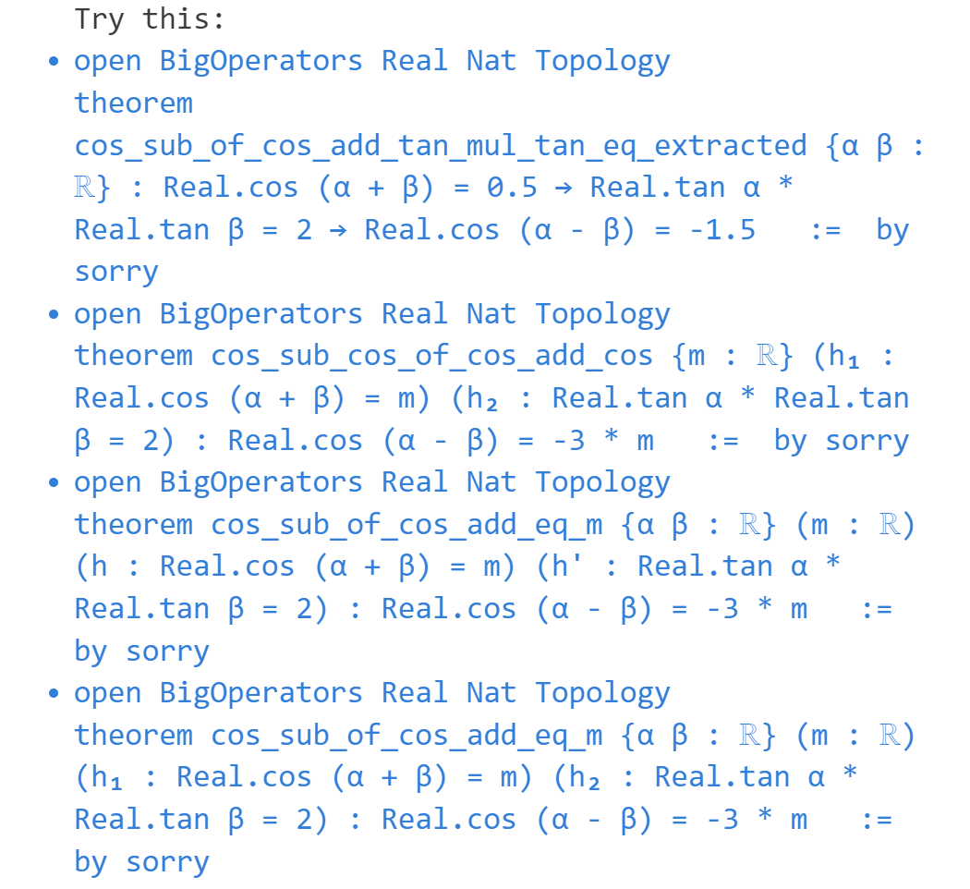
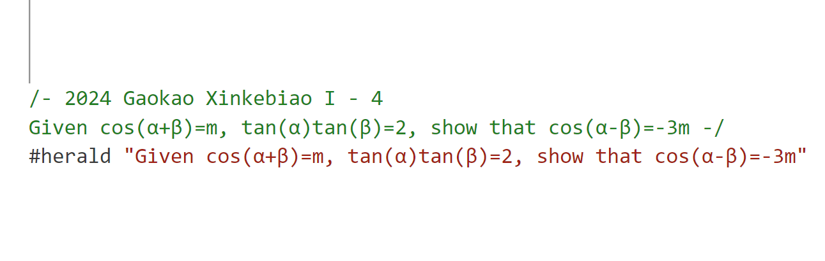
Lean translator

Slide 13
More links
References:
Mechanics of Proof: https://hrmacbeth.github.io/math2001/
Mathematics in Lean: https://leanprover-community.github.io/mathematics_in_lean/
Lean for Curious Mathematicians: https://github.com/lftcm2023/lftcm2023
Previous Episodes in NUS-Math-Formalization:
Calculus Game: https://github.com/NUS-Math-Formalization/CalculusSkeleton
Mathematics in Lean: https://github.com/NUS-Math-Formalization/coxeter
Tools Link:
Leansearch: https://arxiv.org/abs/2403.13310v1
Herald: https://arxiv.org/abs/2410.10878

